Slide 1
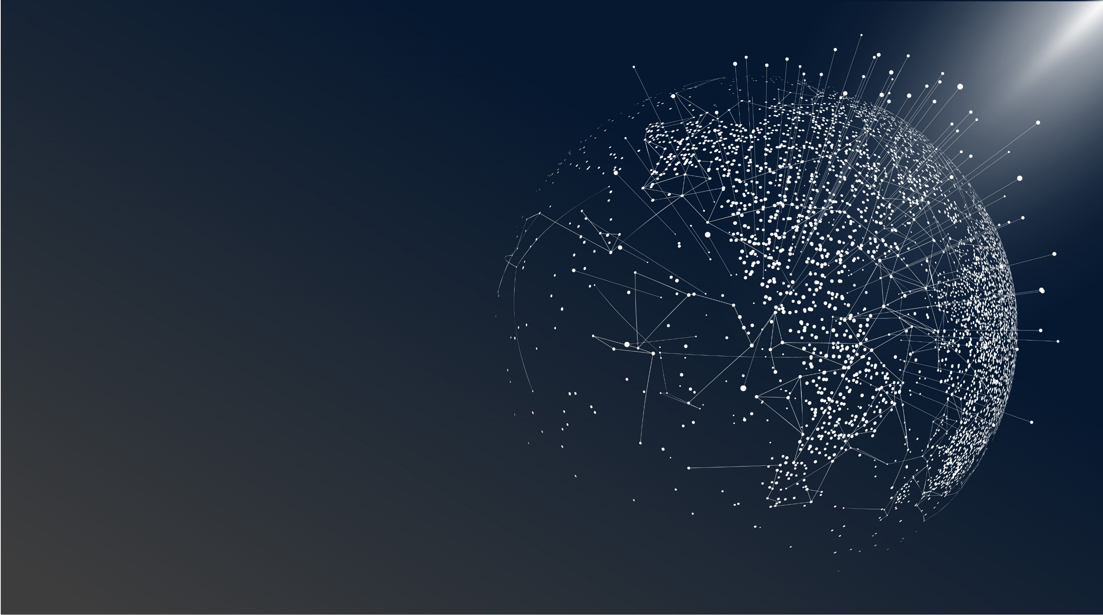
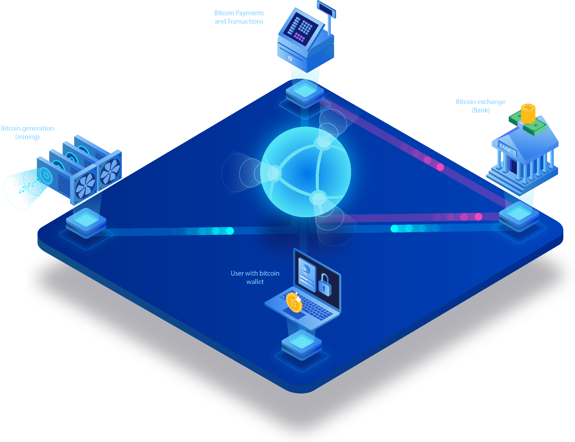
WEEKLY STATUS REPORT
BLOCKCHAIN and its applications in logisticS
Reporters: Thanh Tung – Thanh Phuong
Week 1

Slide 2


CONTENT
1. What is Blockchain?
2. How does Blockchain work?
3. IoT and Blockchain integration.
4. IoT Blockchain in Logistics and Supply Chain Management
Something about Bitcoin.
Bitcoin and Blockchain.
- Some IoT Blockchain usecases.

Slide 3

PART 1
WHAT IS BLOCKCHAIN?

Slide 4

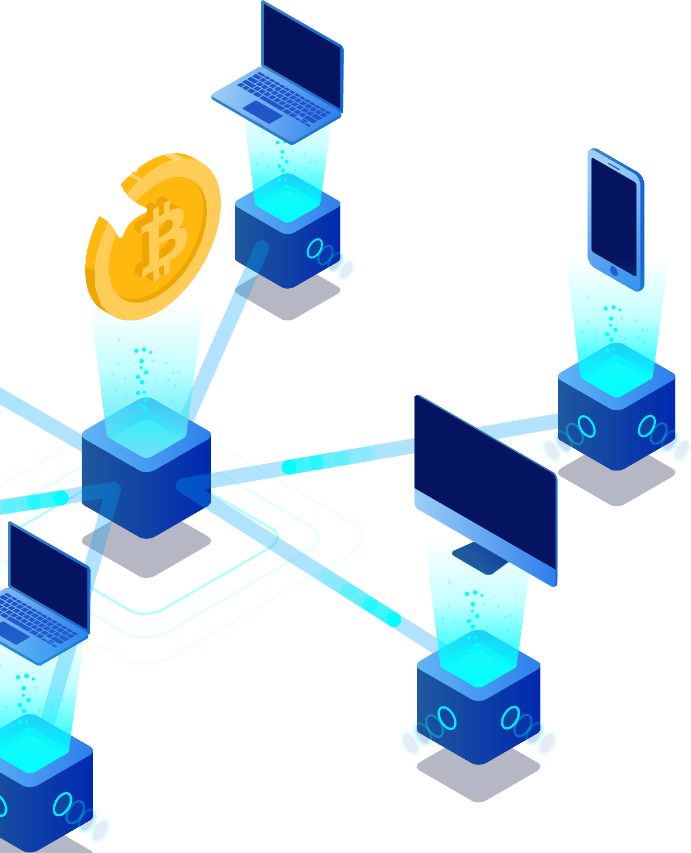
Something about Bitcoin
Bitcoin (₿) is a cryptocurrency, a form of electronic cash. It is a decentralized digital currency without a central bank or single administrator that can be sent from user to user on the peer-to-peer bitcoin network without the need for intermediaries.

Slide 5

Transactions
Mining
Transactions are defined using a Forth-like scripting language.
Mining is a record-keeping service done through the use of computer processing power
Implementations
Decentralization
The first wallet program, simply named Bitcoin, and sometimes referred to as the Satoshi client, was released in 2009 by Satoshi Nakamoto as open-source software.
Bitcoin does not have a central authority and the bitcoin network is decentralized

Slide 6
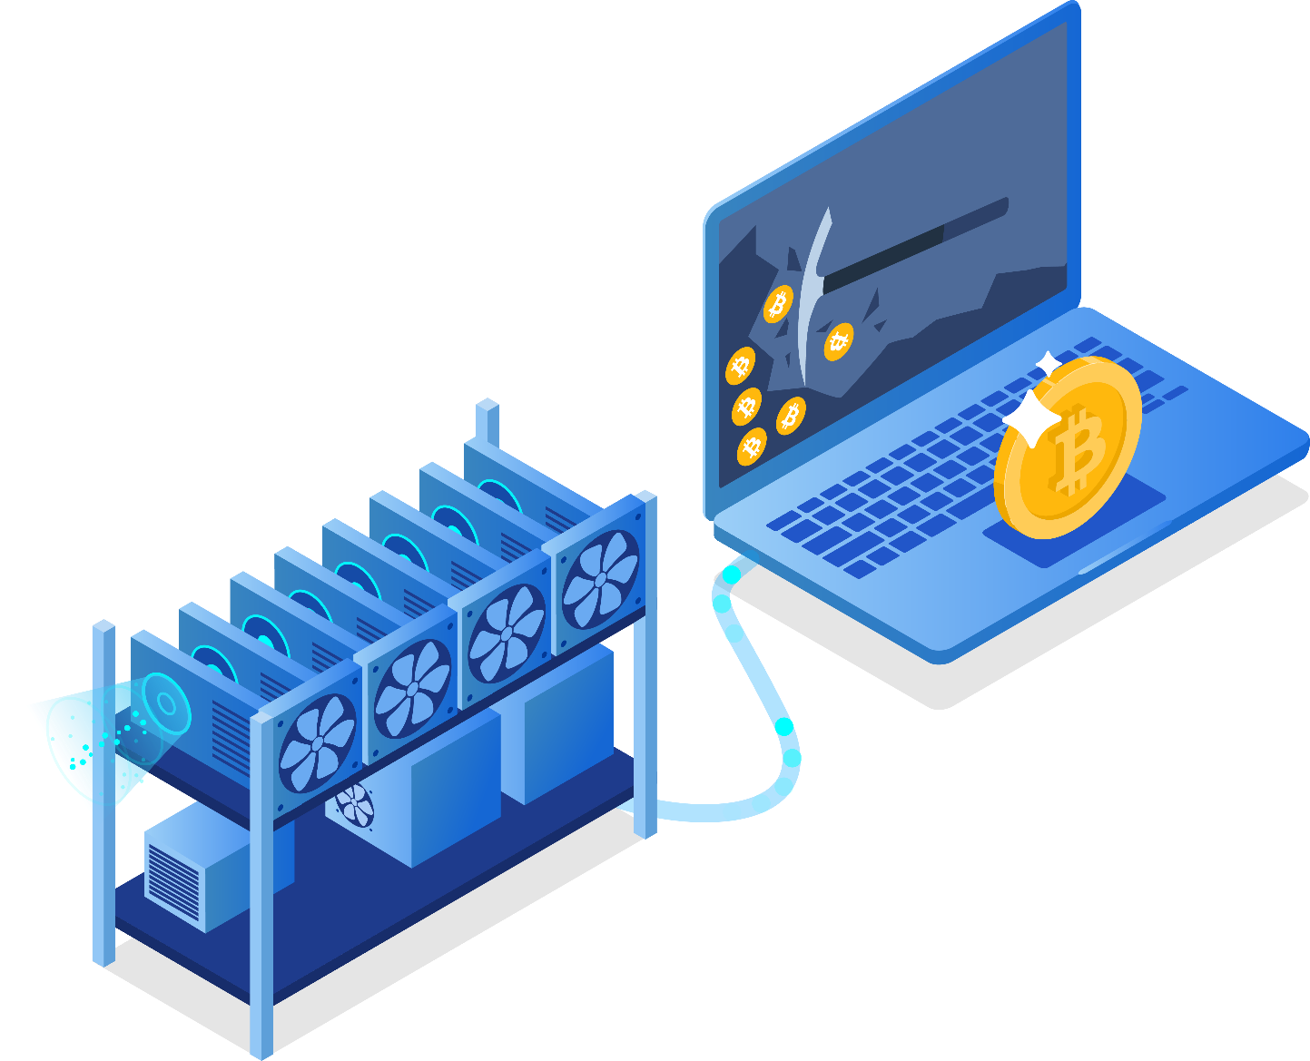
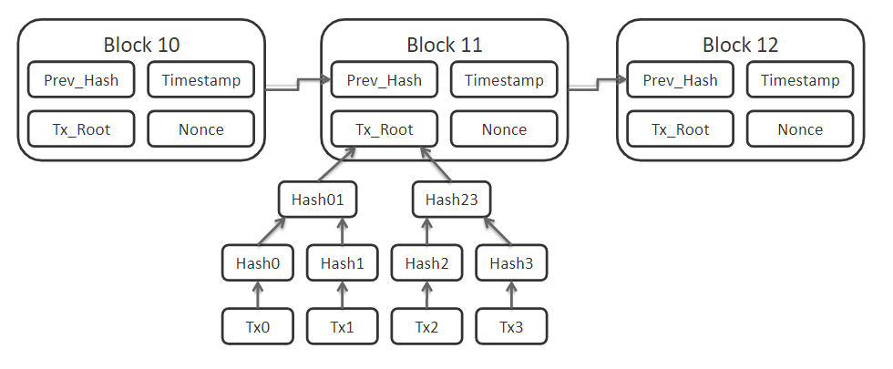
Transactions are verified by network nodes through cryptography and recorded in a public distributed ledger called a blockchain.
Bitcoins are created as a reward for a process known as mining.
Bitcoin network data

Slide 7
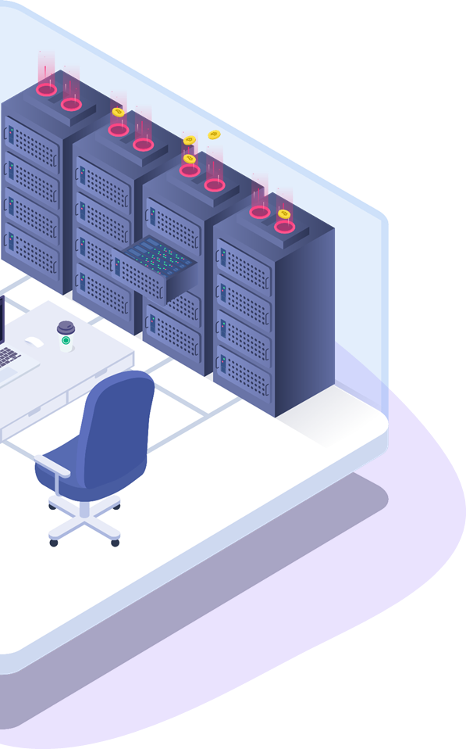
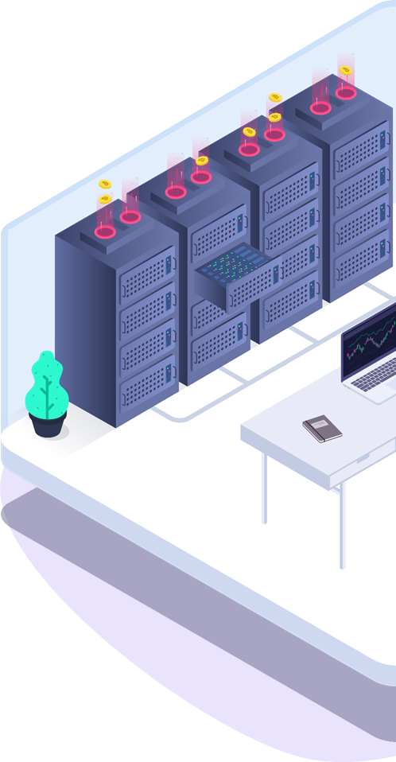
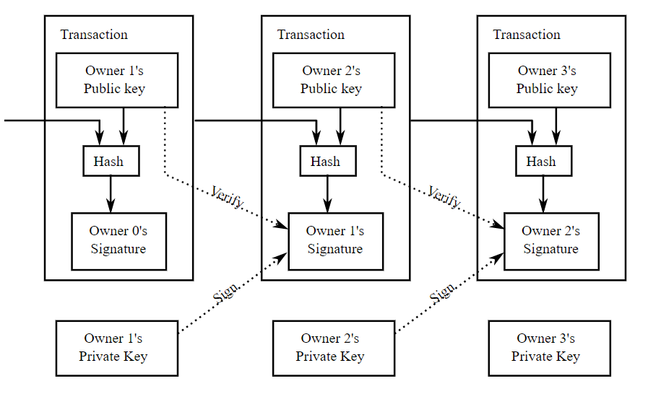
Diagram of a bitcoin transfer
Each block contains a cryptographic hash of the previous block.

Slide 8
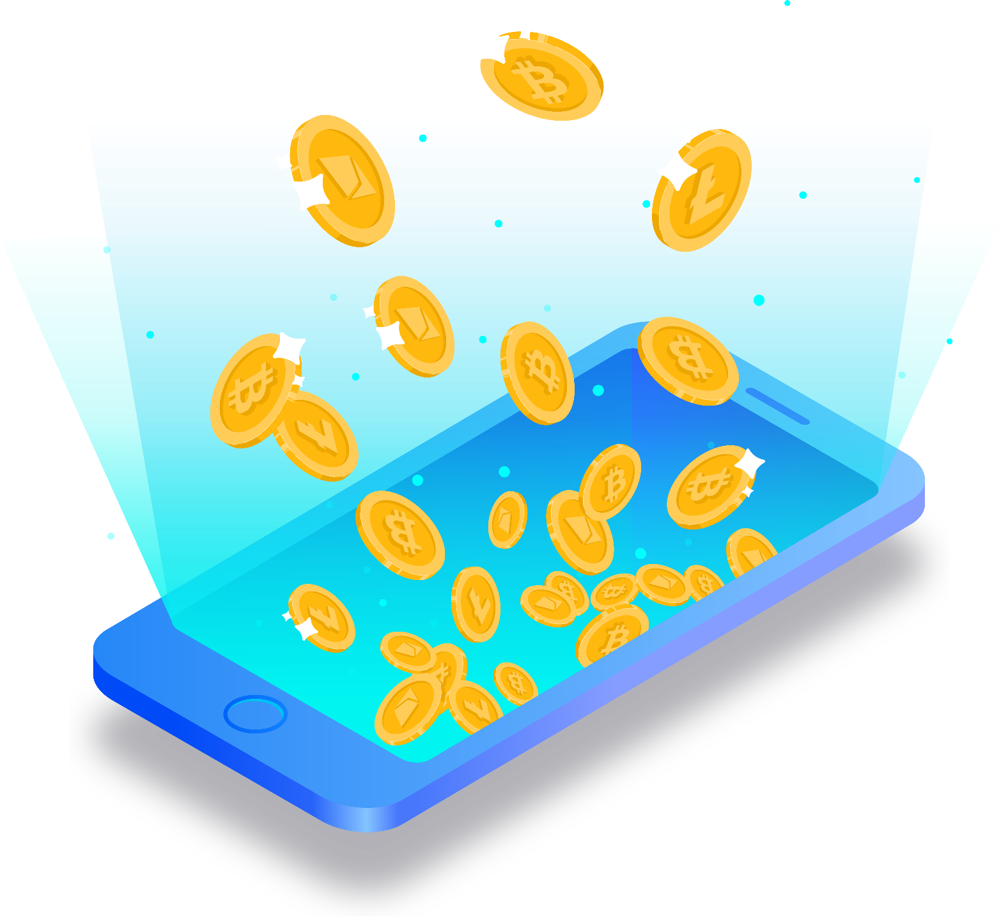
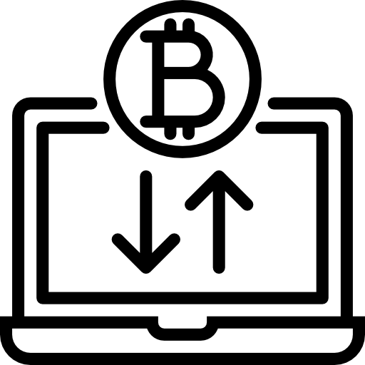
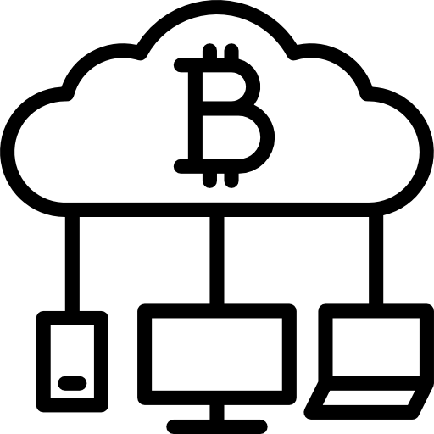
Bitcoin and Blockchain
Bitcoin
Bitcoin (₿) is a cryptocurrency, a form of electronic cash.
Blockchain
Transactions are verified by network nodes through cryptography and recorded in a public distributed ledger called a blockchain.

Slide 9
PART 2
HOW DOES BLOCKCHAIN WORK ?

Slide 10
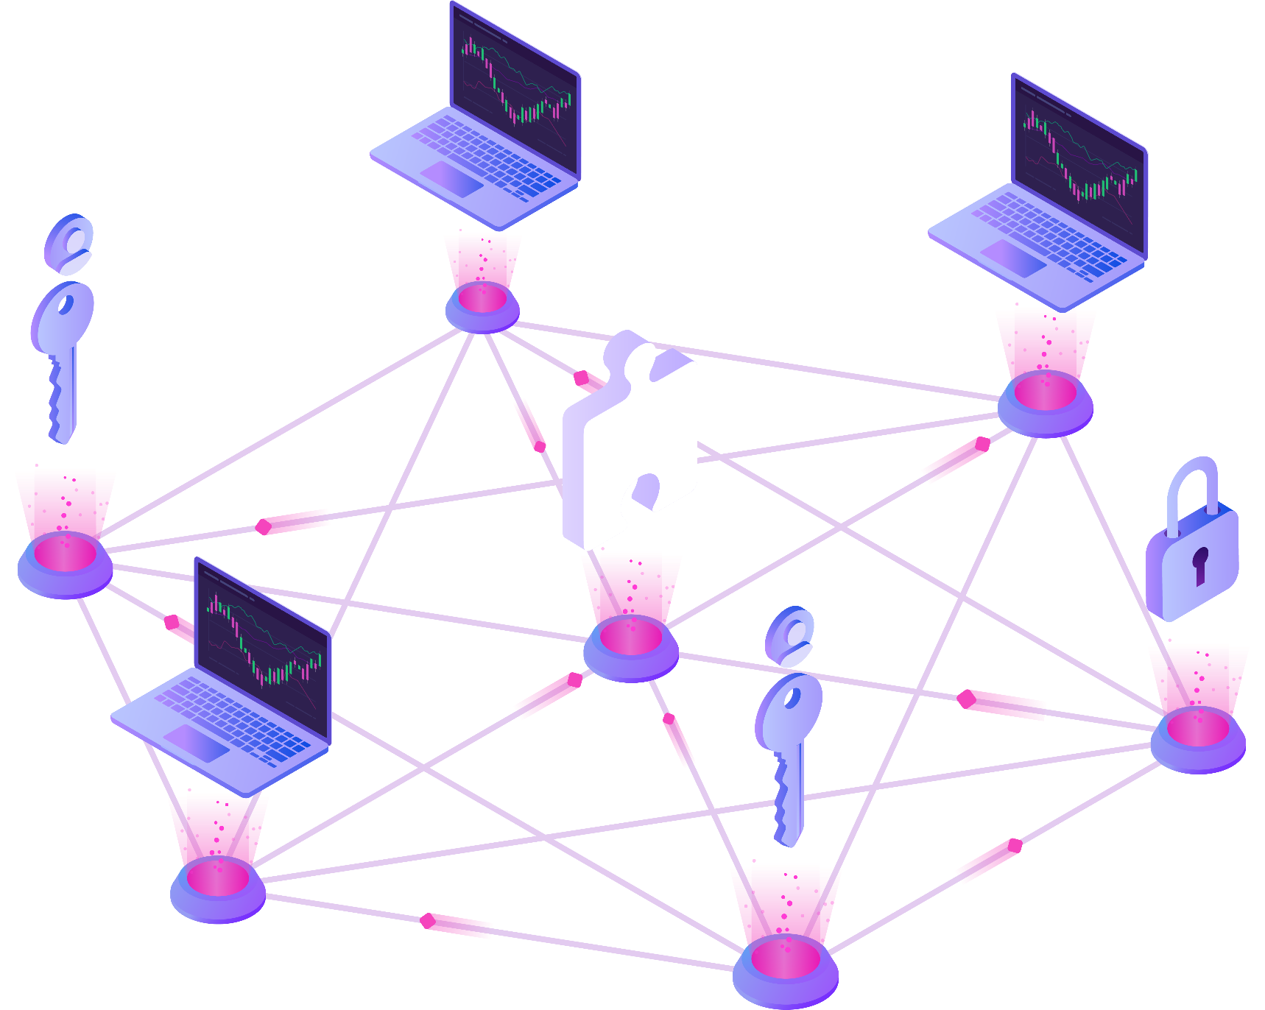
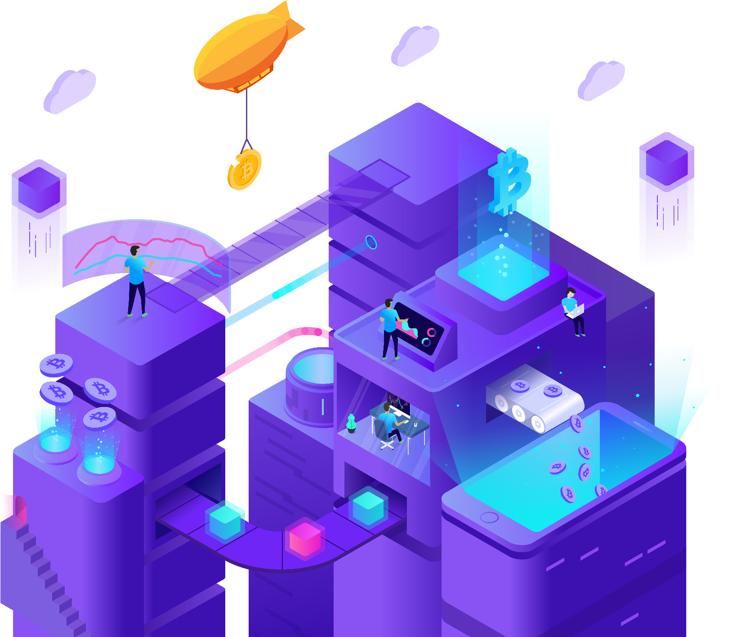
Blockchain
How it works?
A blockchain, originally block chain, is a continuously growing list of records, called blocks, which are linked and secured using cryptography. Each block typically contains a cryptographic hash of the previous block, a timestamp and transaction data.

Slide 11
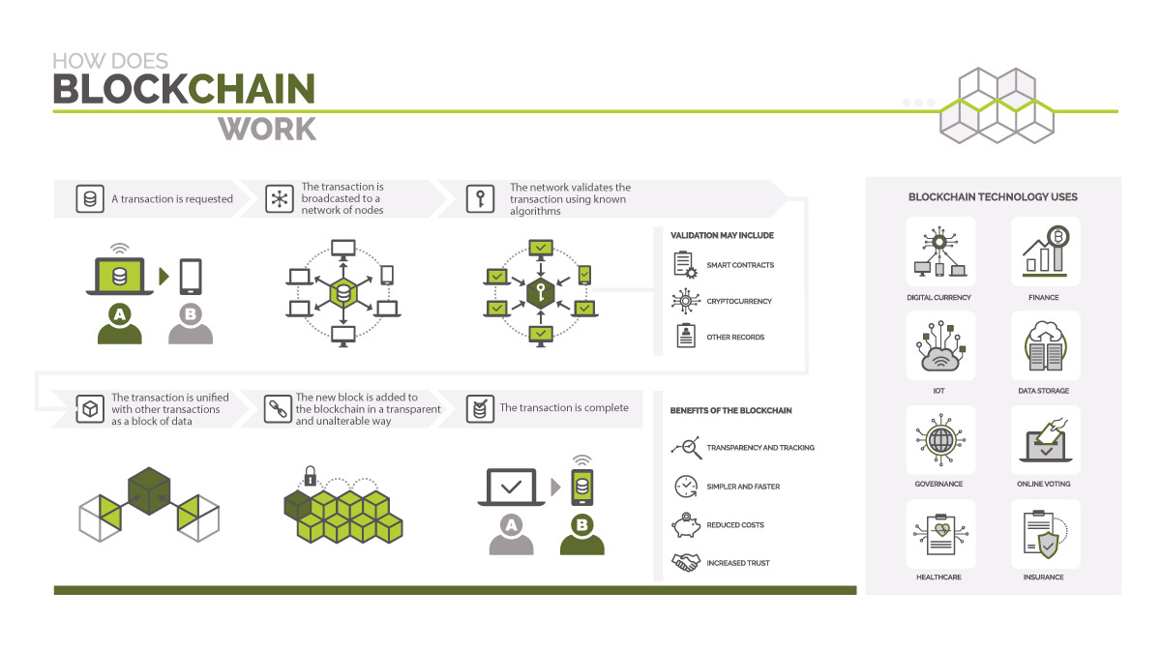

Slide 12
Immutability
Smart contracts
Immutability, in the context of the blockchain, means that once something has been entered into the blockchain, it cannot be tampered with.
Distributed ledgers enable the coding of simple contracts that will execute when specified conditions are met.
Transparent
Better Security
By making the results fully transparent and publicly accessible, distributed database technology could bring full transparency to elections or any other kind of poll taking.
Blockchain technology has a better security because there is not even a single chance of shutting down of the system. Even the highest level of the financial system are subject to get hacked.

Slide 13
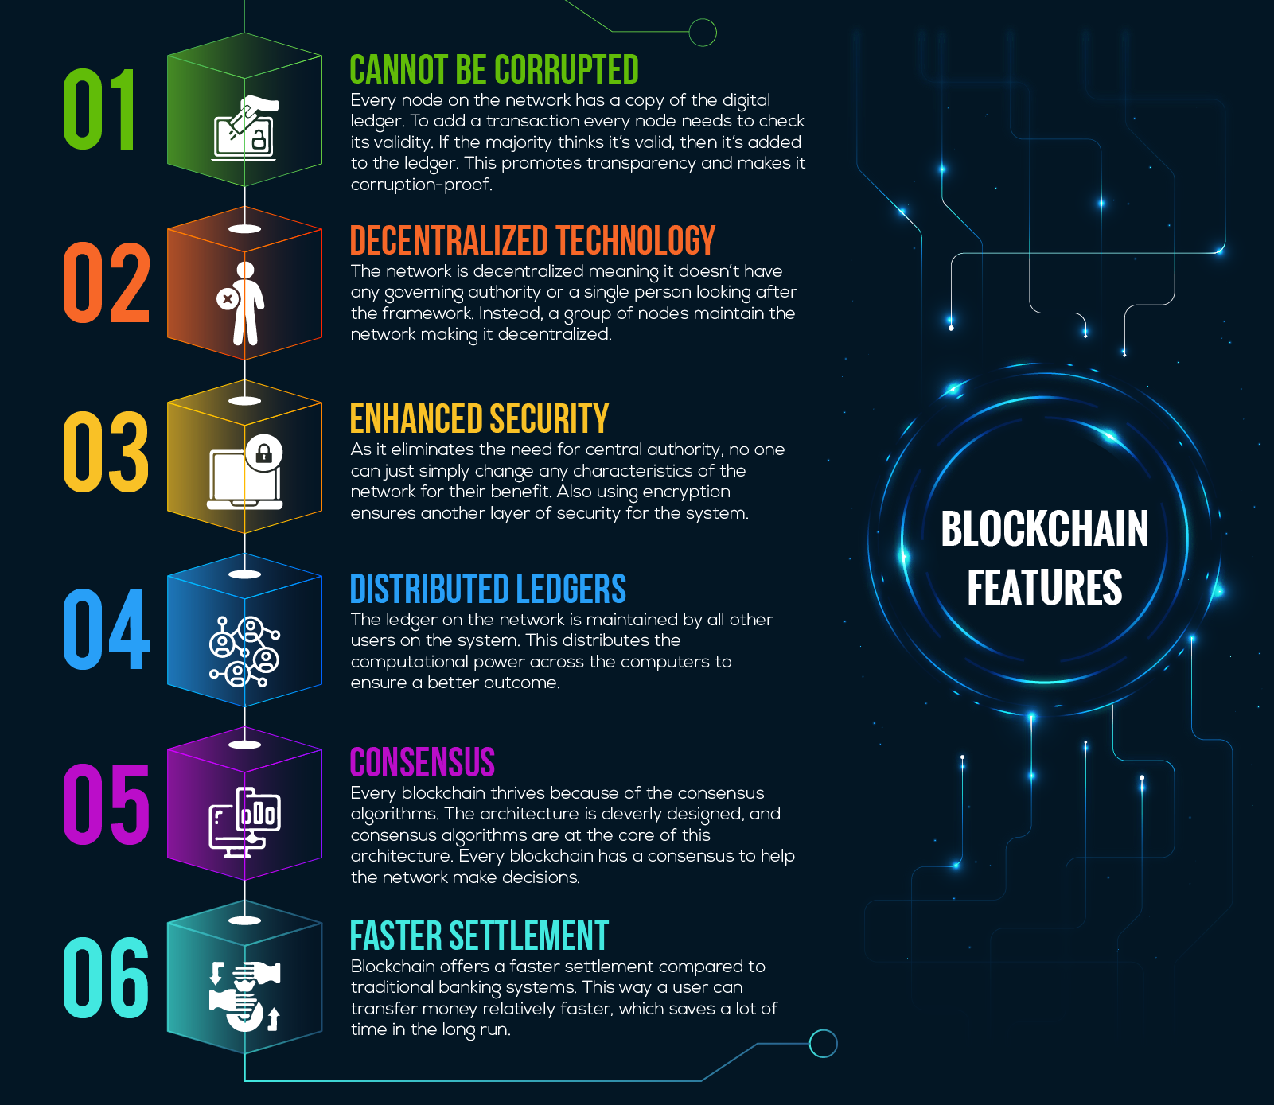
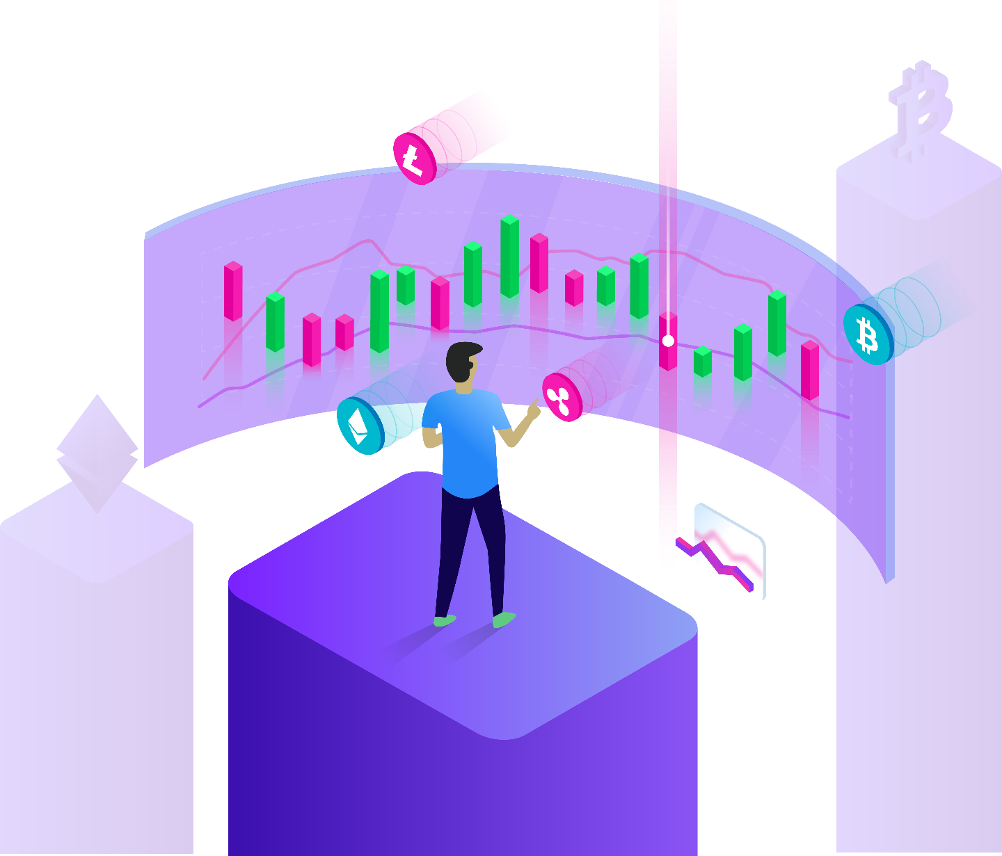
6 major key blockchain features

Slide 14
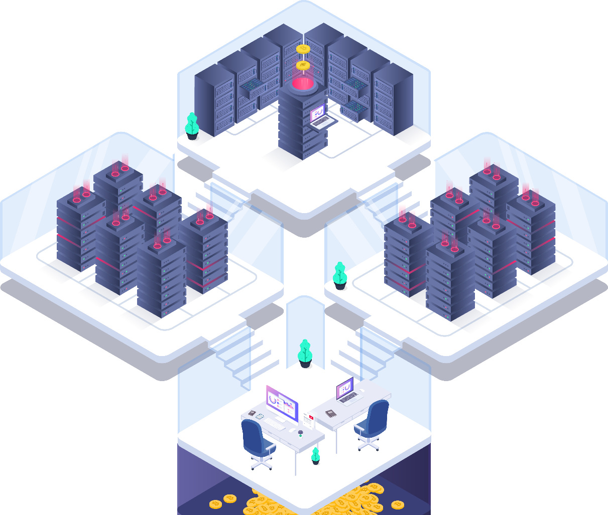
PART 3
IOT AND BLOCKCHAIN INTEGRATION

Slide 15
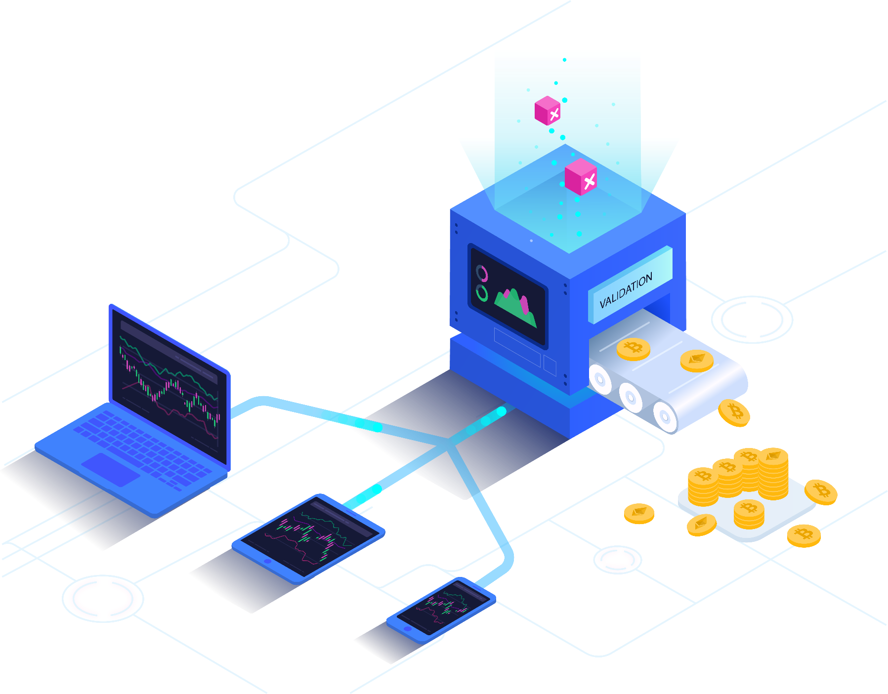
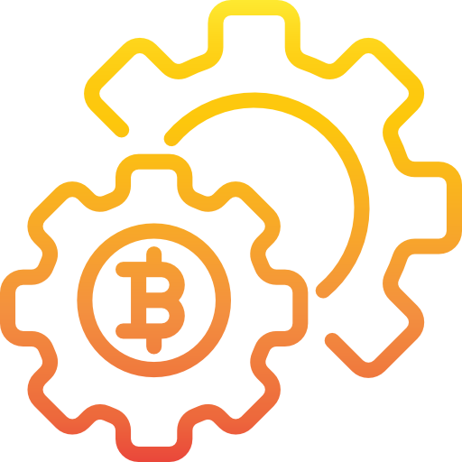
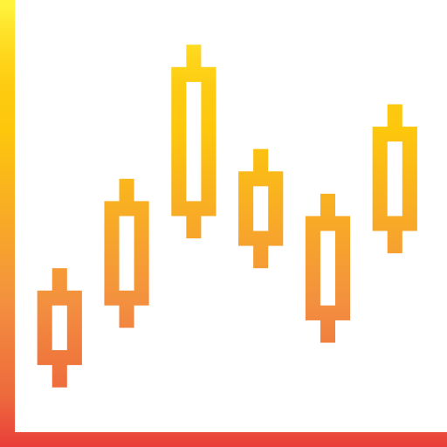
Internet of Things
Blockchain Technology
IoT Analytics predicts the global market for Internet of Things is expected to grow 15% from 2019 to $123B in 2021.
A Young Technology That Could Change Everything

Slide 16
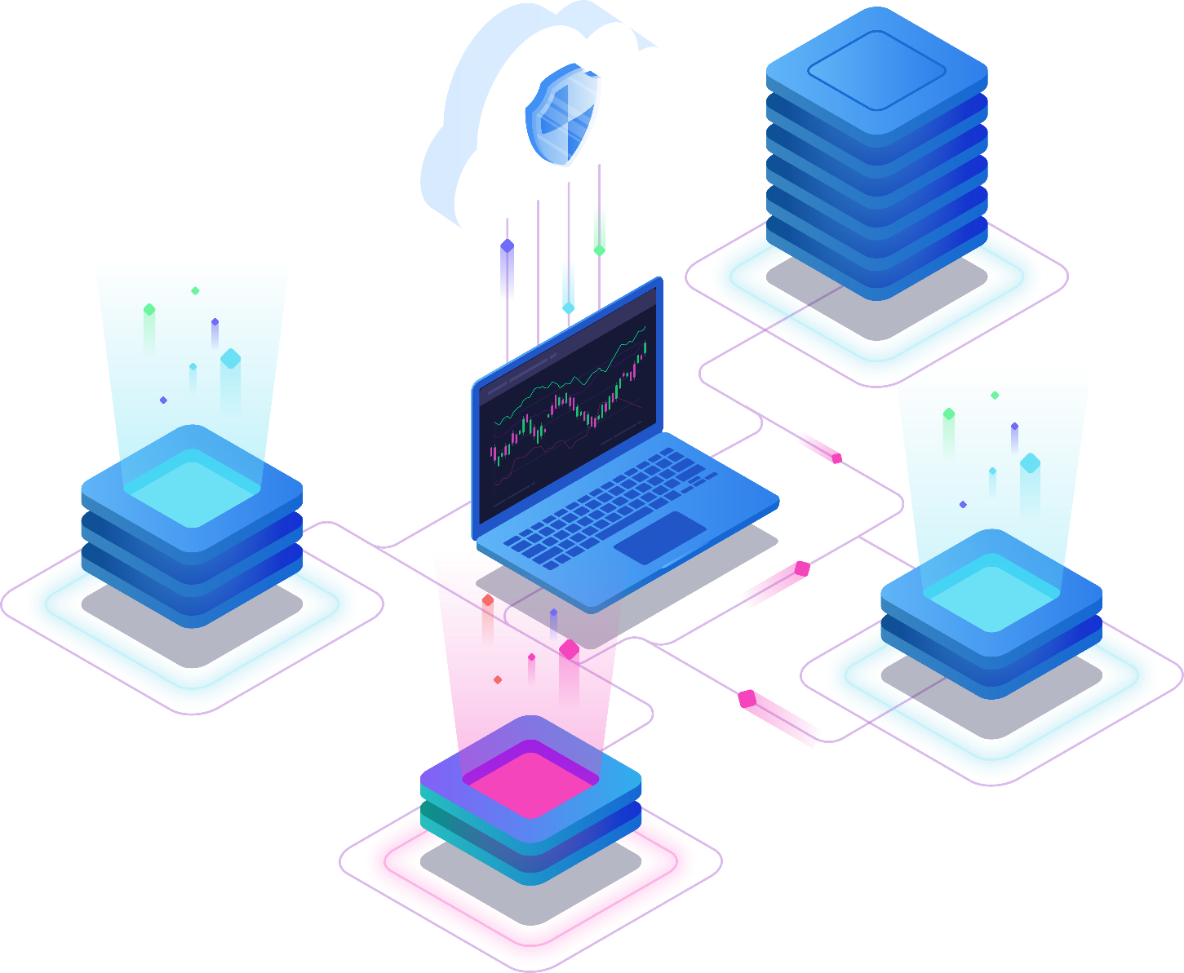
IoT Blockchain
Blockchain has many applications for IoT
Blockchain technology is the missing link to settle scalability, privacy, and reliability concerns in the Internet-of-Things.
Blockchain technologies could perhaps be the silver bullet needed by the IoT industry. Blockchain technology can be used in tracking billions of connected devices, enable the processing of transactions and coordination between devices, allow for significant savings for IoT industry manufacturers.

Slide 17
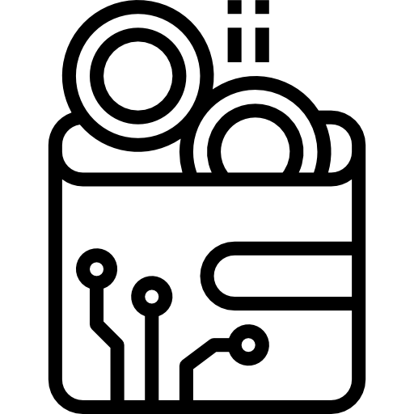
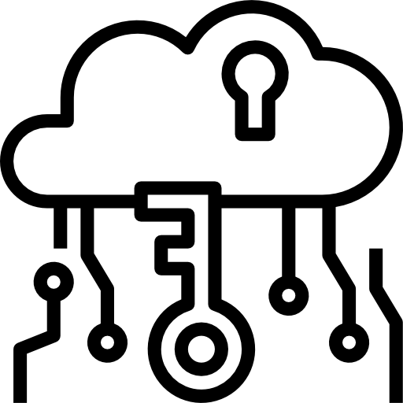
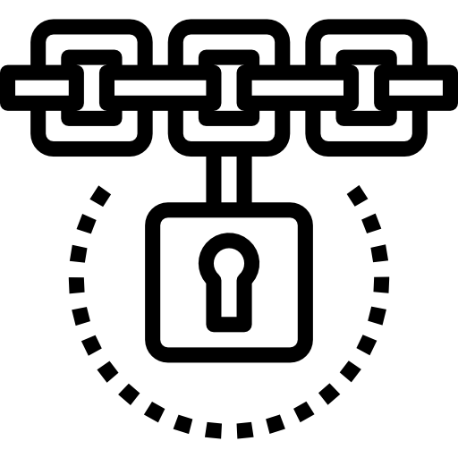
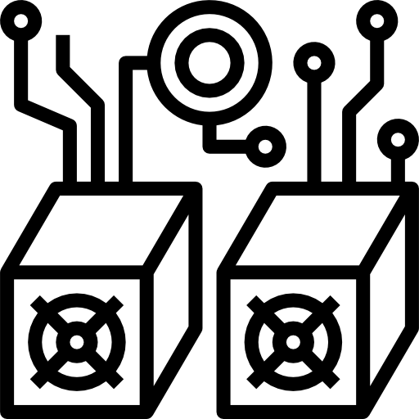
Blockchain can improve some problems of a basic IoT system
Autonomy
Trustworthy
High security
Decentralized

Slide 18
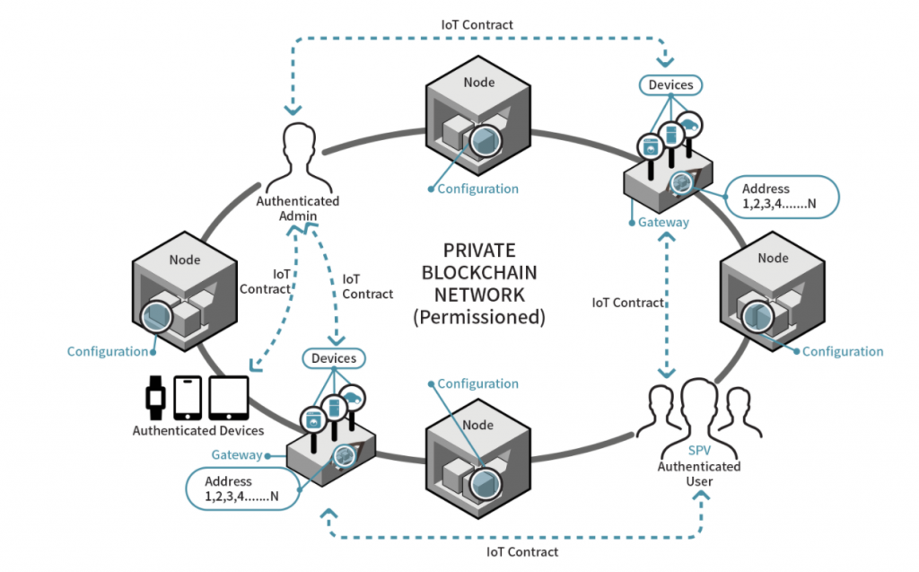
Structure of the IoT blockchain network

Slide 19
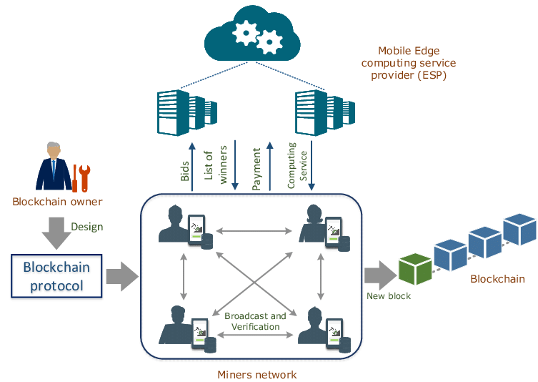
A miner IoT blockchain network

Slide 20
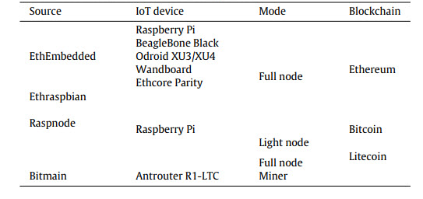
IoT devices to be used as blockchain components

Slide 21
PART 4
IOT BLOCKCHAIN IN LOGISTICS AND SUPPLY CHAIN MANAGEMENT
40%
70%
22%

Slide 22
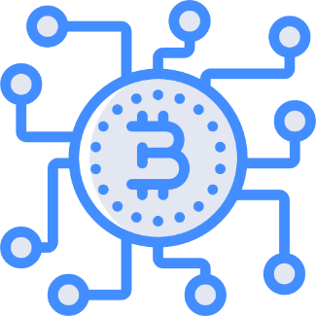
IoT Blockchain in many use cases
Smart Home
Information in door Manage data in your home
Business
Logistics
Contract – Product – HR
Product status – History I/O Date – Time – Location
Education
Transport
Student – Teacher information management
Location – Date – Time
IoT Blockchain use cases

Slide 23
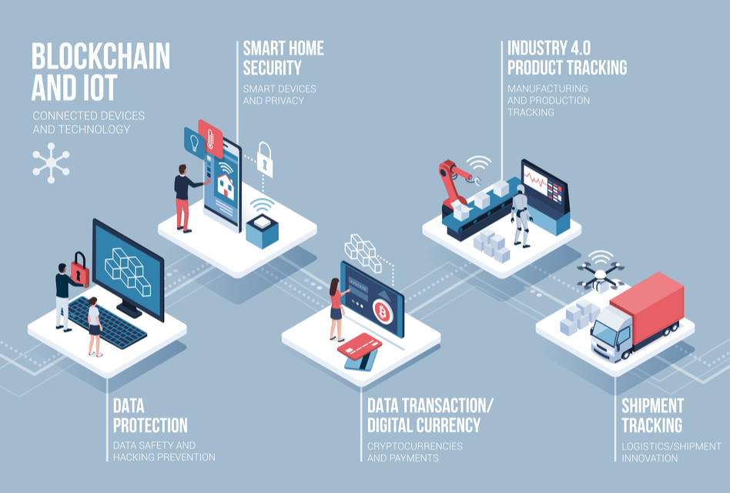
IoT Blockchain in many use cases

Slide 24
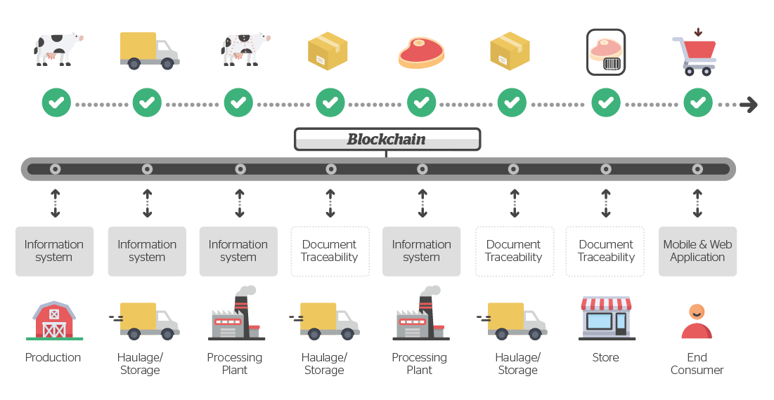
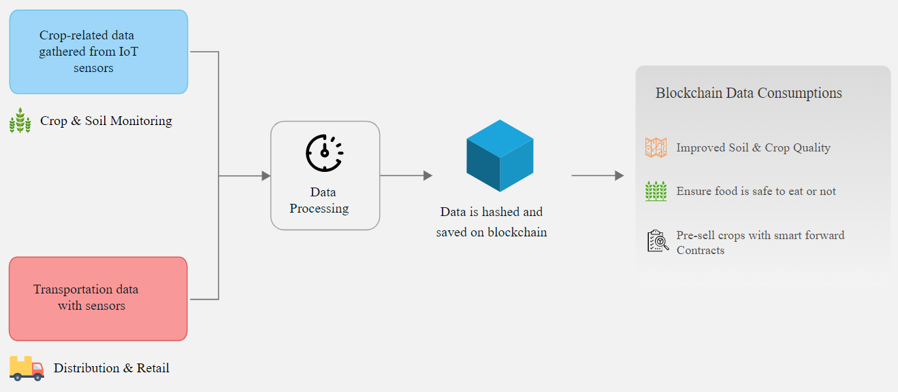
IoT Blockchain in food supply chain
IoT Blockchain in the agricultural supply chain

Slide 25
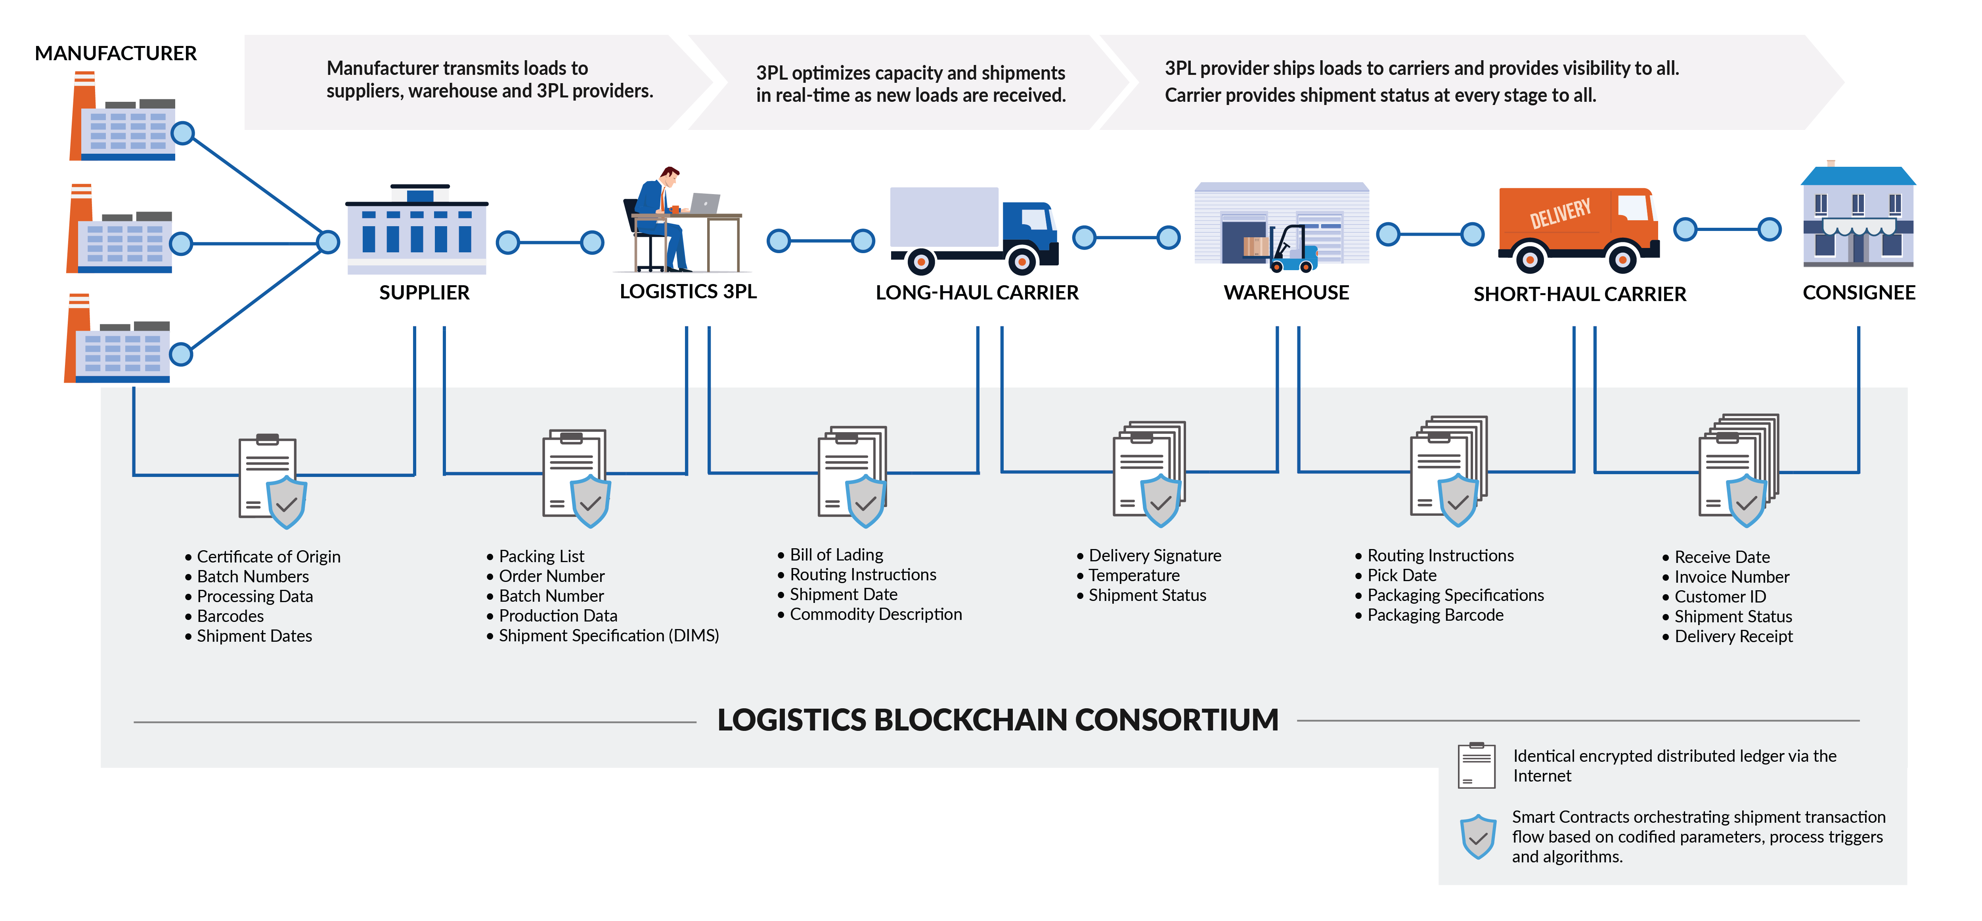
IoT Blockchain in LOGISTICS

Slide 26
Summary
Time
Sensor’s data
LOGICSTICS
Contract
Stored Information in chain data
Bill
Status
Stored history

Slide 27
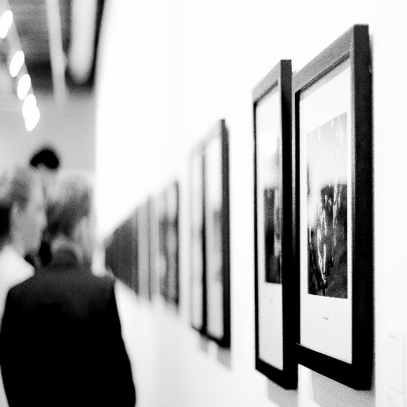

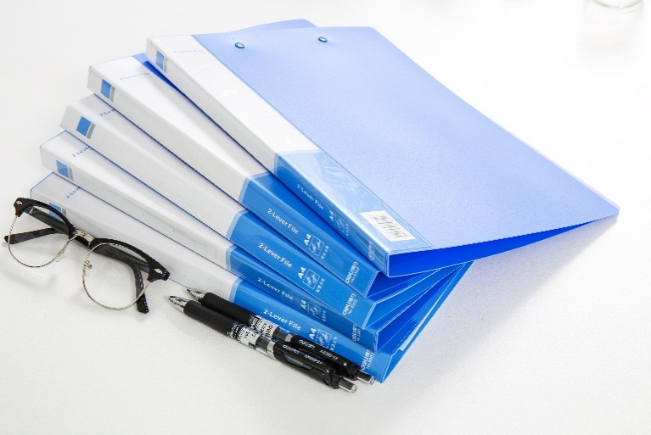
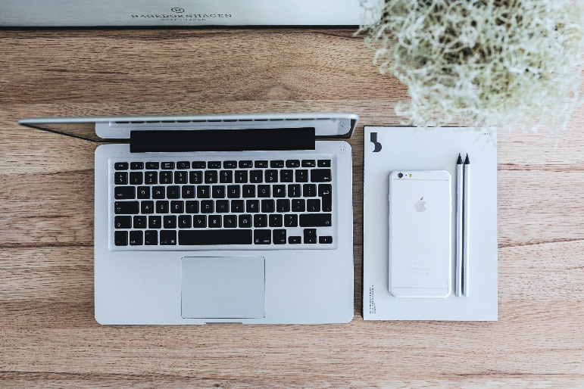
REFERENCE MATERIAL
SOURCE
[ 1 ] Ana Reyna *, Cristian Martín, Jaime Chen, Enrique Soler, Manuel Día – On blockchain and its integration with IoT – Challenges and
opportunities
[ 2 ] Continuous interconnected supply chain – Using Blockchain & Internet-of-Things in supply chain traceability
ONLINE SOURCE
[ 3 ] What is Blockchain Technology? A Step-by-Step Guide For Beginners https://blockgeeks.com/guides/what-is-blockchain-technology/
[ 4 ] Blockchain IoT Use Cases https://www.leewayhertz.com/blockchain-iot-use-cases-real-world-products/
[ 5 ] Wikipedia – Bitcoin, Blockchain
https://en.wikipedia.org/wiki/Bitcoin https://en.wikipedia.org/wiki/Blockchain

Slide 28

THANK YOU
FOR YOUR LISTENING

